Slide 1


Interlayer Excitons
in Two-Dimensional Heterostructures
王云坤
2018.12.19

Slide 2

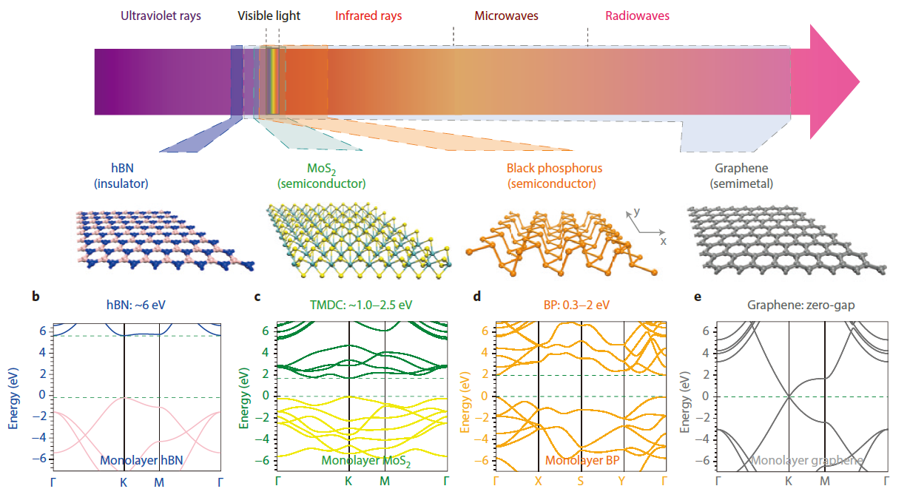
Different Two-Dimensional Materials
Nature Photonics, 2014, 8(12): 899.

Slide 3
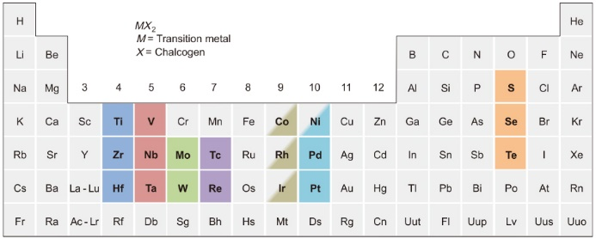
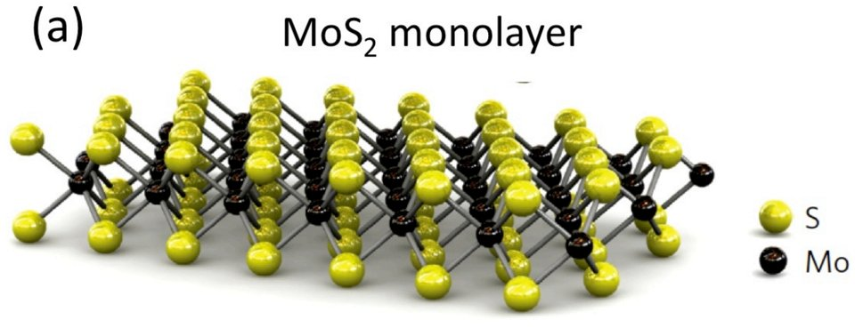
Transition Metal Dichalcogenides (TMDs)
Four principal members：
MoS₂
WS₂
MoSe₂
WSe₂
Nature chemistry, 2013, 5(4): 263.

Slide 4
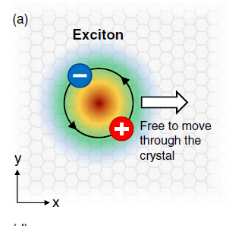
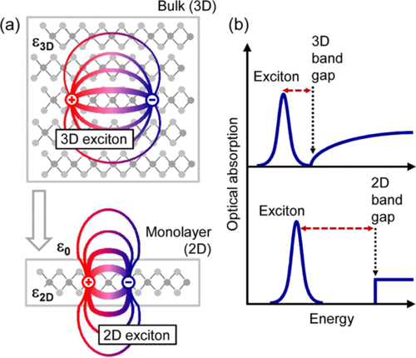
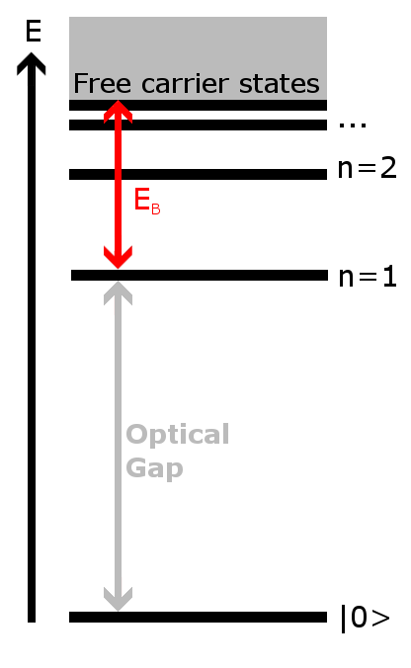
Excition in TMDs
An exciton is a bound state of an electron and an electron hole which are attracted to each other by the electrostatic Coulomb force.
The reduced dielectric screening and the quantum size effect present in these ultrathin materials make the binding energy (E_{b} ~500meV) of excitons much stronger than those in traditional semiconductors.
E_{b}
Physical review letters, 2014, 113(7): 076802.

Slide 5
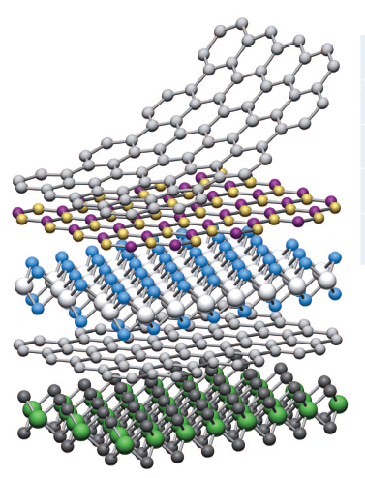
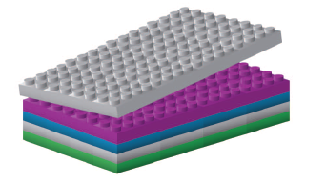
Two-Dimensional Heterostructures
If we could construct atomic-scale Lego?
Lego blocks
Heterostructures
Nature, 2013, 499(7459): 419.

Slide 6
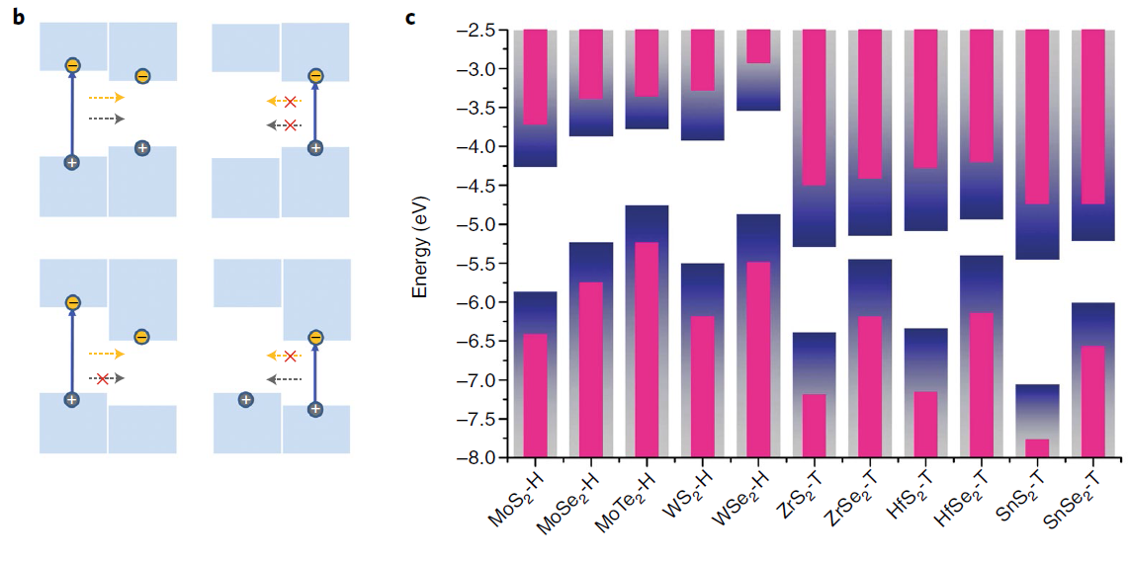
Band alignment of 2D Heterostructures
Allowed charge transfer
Type I
Type II
Type III
-
+
+
Ab initio density functional theory calculation
-
-
+
Nature nanotechnology, 2018, 13(11): 994.

Slide 7
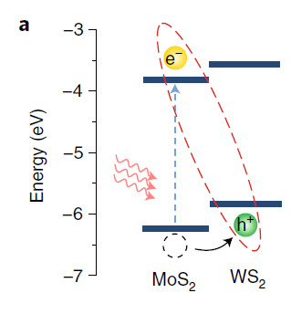
Absorption and Emission of Light
Type II Band alignment
E_{C}
Short timescales (＜1ps)
the charge transfer and energy relaxation processes
interlayer exciton
~1ns(10³ps)
Longer timescales (~1ns),
the recombination of interlayer excitons and relaxation of the spin and valley degrees of freedom become relevant.
E_{V}
+
一
＜1ps
MoS₂
WSe₂
Nature nanotechnology, 2018, 13(11): 994.

Slide 8
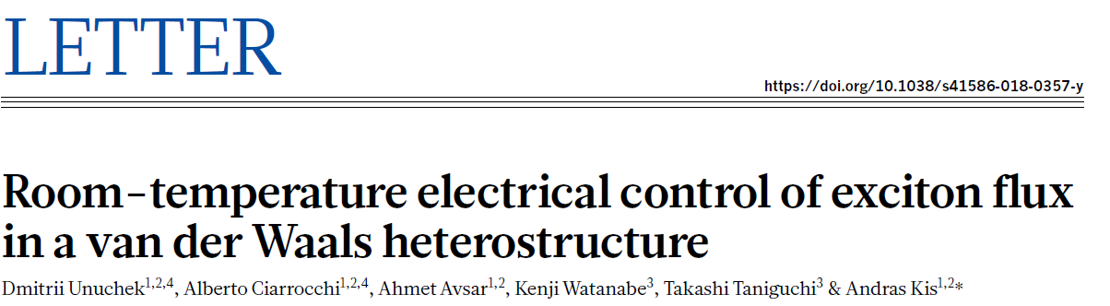
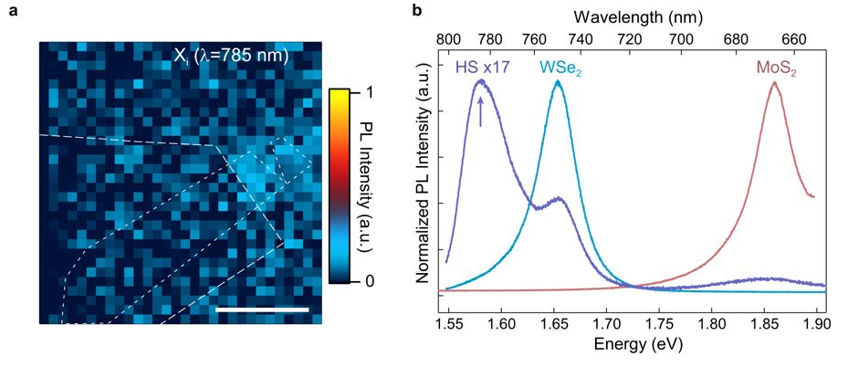
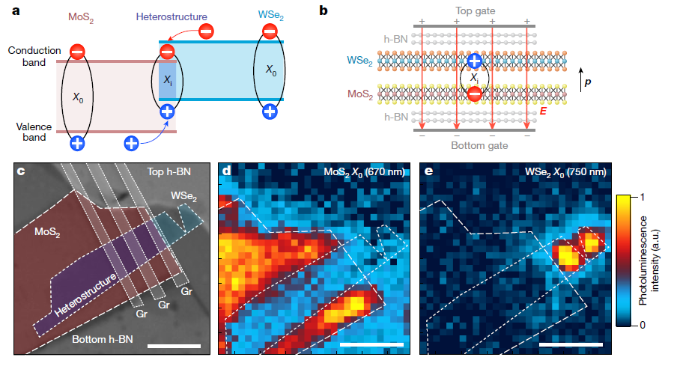

Excitonic Transistor
$$δE=−p_{z}E_{z}$$
Nature, 2018, 560(7718): 340.
Notes:
The extremely rapid (few femtosecond) relaxation times inferred for high-lying states may, however, remain difficult to probe directly in the time domain, but are easily observable by lineshape analysis

Slide 9
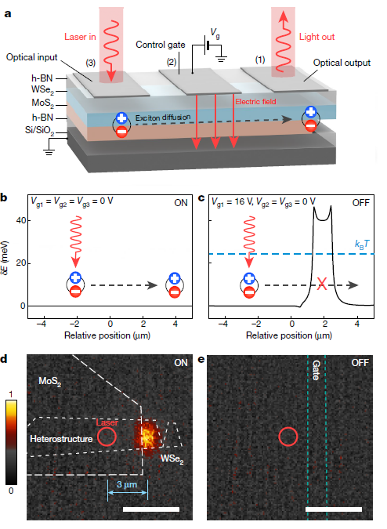
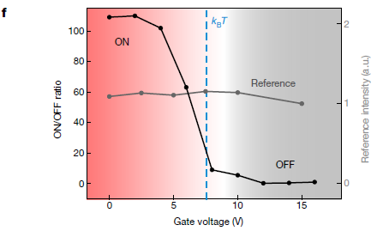

Excitonic Transistor
Diffusion
“Excitonic Transistor”
$$T∝E_{b}k_{B}$$
Nature, 2018, 560(7718): 340.
Notes:
The extremely rapid (few femtosecond) relaxation times inferred for high-lying states may, however, remain difficult to probe directly in the time domain, but are easily observable by lineshape analysis

Slide 10
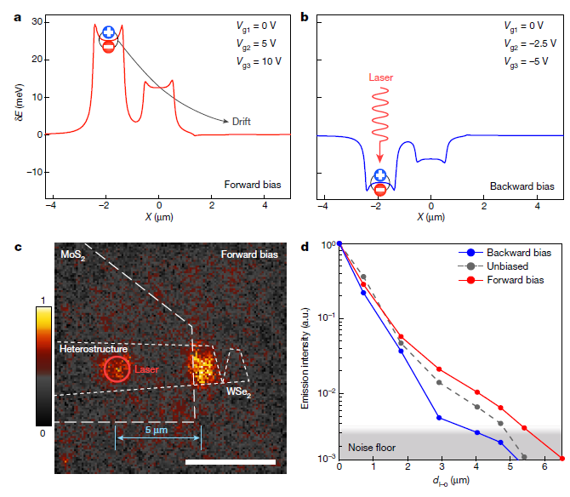
Excitonic Transistor
Nature, 2018, 560(7718): 340.
Notes:
The extremely rapid (few femtosecond) relaxation times inferred for high-lying states may, however, remain difficult to probe directly in the time domain, but are easily observable by lineshape analysis

Slide 11
Thanks for your attention
王云坤
2018.12.19

